Slide 1
Ship-based Robotics
An Enabling Technology for Manned and Autonomous Vessels
Tremough Innovation Centre,University Campus, Penryn, Cornwall
26th september 2019

Slide 2
OVERVIEW OF THE SHIP-BASED ROBOTICS R&D PROGRAMME
David Kirkley
Managing Director
Submarine Technology Limited
7 Mariners Way, Cowes, Isle of Wight, PO31 8PD

Slide 3
Submarine Technology Limited (STL for short) engages in pre-commercial R&D and early-stage commercial projects for the sub-sea and offshore industries.
Over several years, STL has developed a “space-stabilised” robotic arm to safely transfer personnel from a ship to a fixed offshore structure such as a platform or wind turbine.
This project – code-named Neptune – is at full-size prototype stage with 20m height capability and 20m reach.

Slide 4
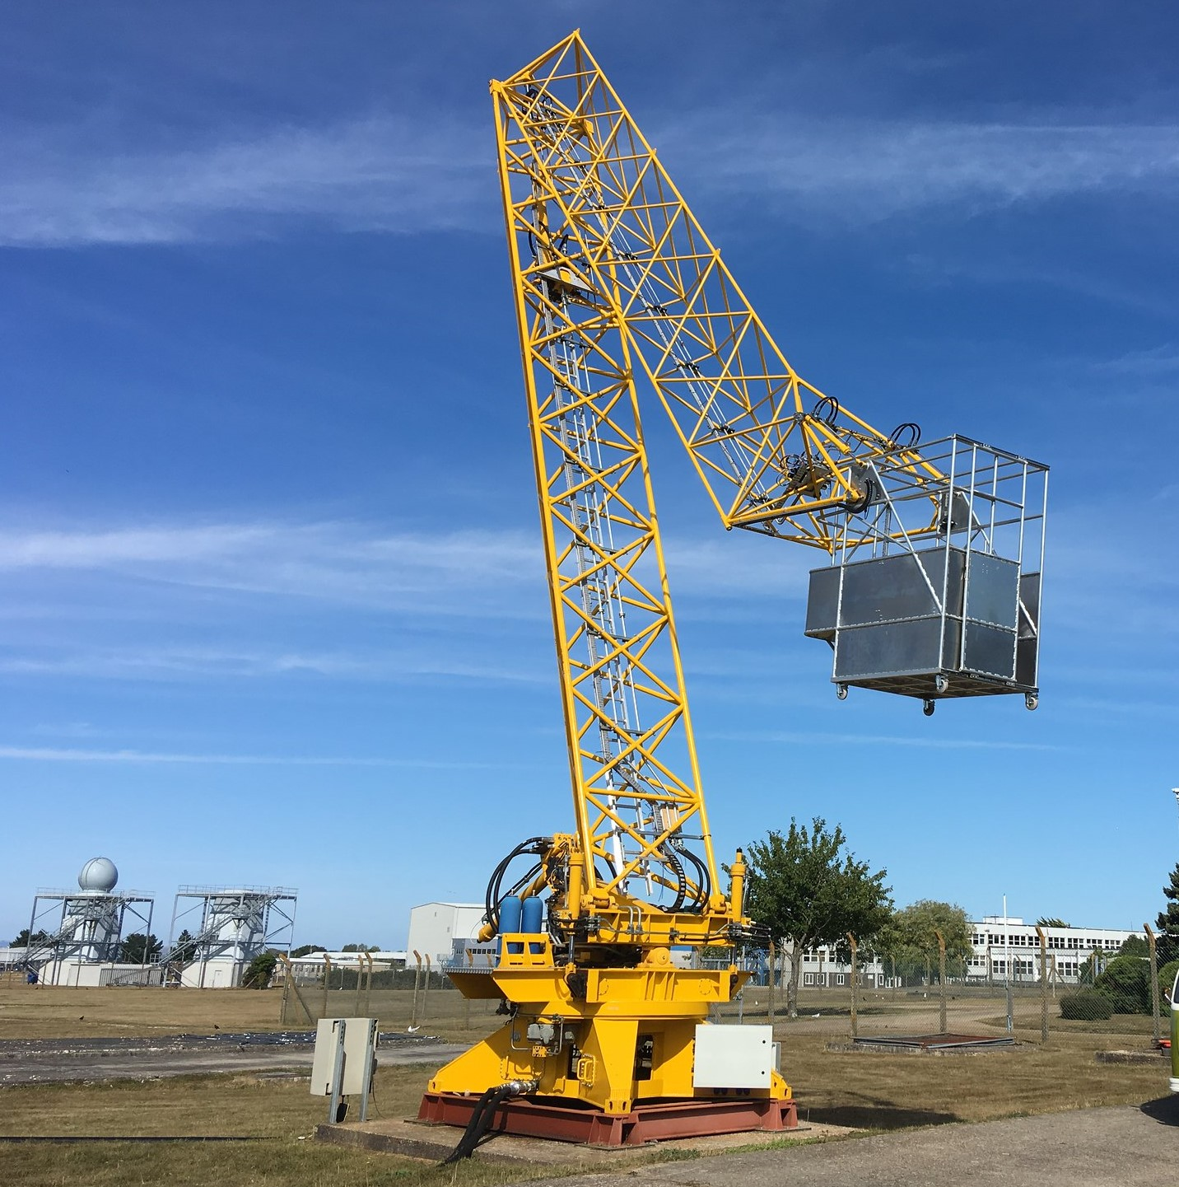

Slide 6
Neptune technology enables a payload (people or cargo) to be deployed within an access envelope where all ship-motion is removed: roll, pitch, yaw, heave, surge, sway.
A key aspect is the control system that senses ship motion and instructs actuators to move parts of the arm to achieve payload stabilisation.
Although personnel transfer was the original aim, the resulting robotic arm can be applied to other tasks, especially if it can achieve “synchronous stabilisation”.

Slide 7
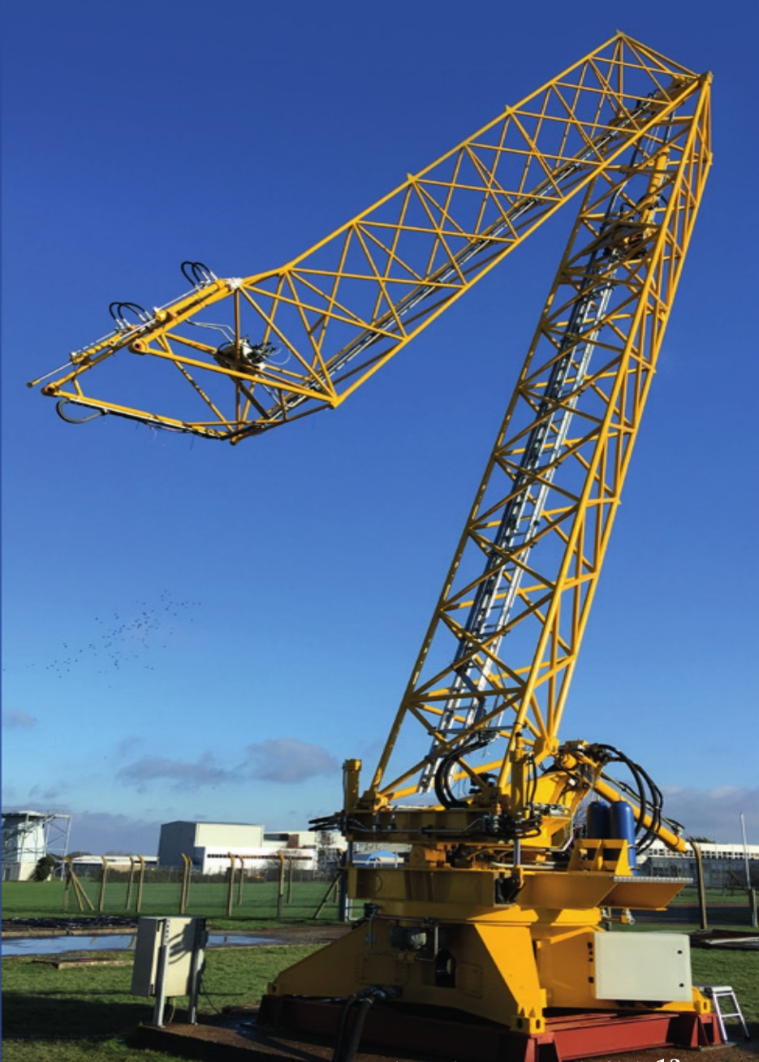

Slide 8
With “synchronous stabilisation”, the payload and moving- target motions are synchronised, e.g. ship or floating device.
STL proposed to extend the Neptune technology to provide an Autonomous Synchronised Stabilised Platform (ASSP) with support from the ERDF-funded Marine-I programme.
It involved building a small-scale robotic arm to mount on a ship-motion simulator, a moving-target test rig, and an enhanced control system.

Slide 9
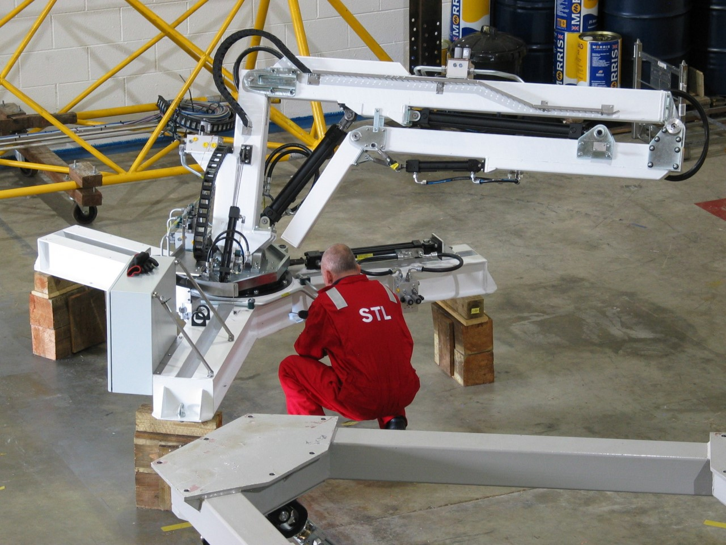

Slide 10
First-stage tests use hardwire feedback from the ASSP, MTTR and motion-simulator position sensors.
Stage 2 tests involve hardwire feedback from the ASSP and motion-simulator but telemetry from the MTTR that has its own IMU
Stage 3 tests will use remote optical sensing from the ASSP without feedback from the MTTR

